Slide 1
Probabilistic & Bayesian Reasoning
Knowledge based system
Adnan Majeed
Data scientist and researcher

Slide 2
1. Probabilistic Reasoning
🔹 📌 Definition
Probabilistic reasoning is a method of handling uncertainty using probability theory. It helps systems make decisions when information is incomplete or uncertain.
📌 Key Concepts
Probability (P): Likelihood of an event (0 to 1)
Random Variables: Variables with uncertain values
Prior Probability: Initial belief before evidence
Posterior Probability: Updated belief after evidence
📌 Example
If a patient has a fever, what is the probability they have malaria?

Slide 3
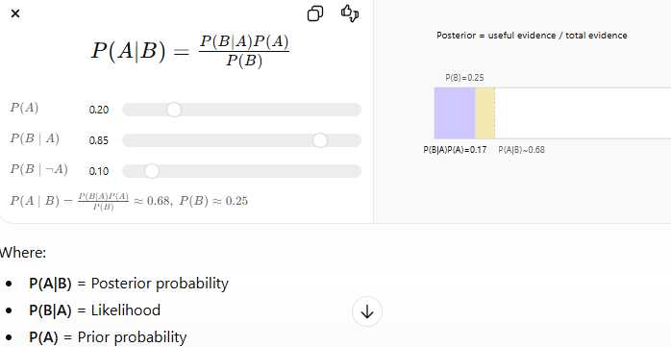
2. Bayesian Reasoning
📌 Definition
Bayesian reasoning updates probabilities based on new evidence using Bayes' Theorem.
📌 Formula
P(B) = Evidence probability

Slide 4
📌 Explanation
Start with prior belief
Update belief when new data arrives
Used in decision-making under uncertainty
📌 Example
Spam email detection
Medical diagnosis

Slide 5
📘 Bayesian Networks
🔹 Definition
A Bayesian Network is a graphical model that represents variables and their probabilistic relationships.

Slide 6
🔹 Components
1. Nodes
Represent random variables
Example: Rain, Traffic, Accident
2. Edges
Show dependencies between variables
3. Conditional Probability Tables (CPT)
Define probability of each node given its parents

Slide 7
🔹 Structure
Directed Acyclic Graph (DAG)
No cycles allowed
🔹 Example
Rain → Traffic → Late
Rain affects traffic
Traffic affects lateness

Slide 8
🔹 Advantages
Handles uncertainty effectively
Easy to understand and visualize
Supports reasoning and prediction
🔹 Inference in Bayesian Networks
Predictive Reasoning (cause → effect)
Diagnostic Reasoning (effect → cause)
Intercausal Reasoning

Slide 9
📘 Applications of Probabilistic & Bayesian Reasoning
🔹 1. Medical Diagnosis
Disease prediction based on symptoms
Example systems like MYCIN

Slide 10
🔹 2. Spam Filtering
Classifying emails using probability
Widely used in email systems
🔹 3. Machine Learning
Core part of Artificial Intelligence
Used in classification and prediction

Slide 11
🔹 4. Risk Analysis
Financial forecasting
Insurance risk evaluation
🔹 5. Robotics
Decision-making under uncertainty
Sensor data interpretation

Slide 12
🔹 6. Natural Language Processing
Speech recognition
Language translation
🔹 7. Fault Diagnosis Systems
Detect faults in machines and networks

Slide 13
📘 Summary
Probabilistic reasoning deals with uncertainty
Bayesian reasoning updates beliefs using evidence
Bayesian Networks model complex relationships
Widely used in AI applications and real-world systems

Slide 14
AI AGENT ?
WORKFLOW AUTOMATE ?
2026 -→ automation , ai model, ai prototype, AI AGENT
Abc employee (thinking strategy? )
Xyz company --=> (ABC EMP, GRADUATE FROM LEADS)
HABITS ***** SIR G NUMBER LA DIYO SIR, G PAPER KEHO JIYA ANA
SIR G GUESS DUS DIY0 SIR SESSIONAL NUMBER PORAY LA DIYO
SIR CGPA THALLY DIG GIYA (AINNO UTTAY CHUKNA AY) B+
A-

Slide 15
AI AGENT?
THINKING STRATEGY>?
WHAT PEOPLE INTEREST IN YOUR PORFILE?
WORK , EXPERIENCE, OUTCOMES , DEVELOP
NO BODY ELSE IS INTERESTED IN YOUR CGPA ?(2026)
MACHINE LEARNING MODEL, AI AGENT, SMALL ROBOT
MARKET (HOW THE PERSON IS SURVIVE)
JUGGAD BAZZI (LATE, KAM CHORI KARA, CHUTTI MAR LAY)

Slide 16
COMPANY SUFFERING?
HUMAN BEHAVIOR DETECTION (DURING THE ATTENDANCE)
MACHINE LEARNING MODEL (HUMAN FACIAL DETECTION)
A. POSTURE DETECT(PAN , LAL RANG)
HAND CARRAY CIGRATE (CIGAR, SHEESHA)
COMPANY ALERT → TIME, ENERGY , SALARY DESTROY
2020 MACHINE LEARNING (DETECT, DEPLOY, ANALYSIS)

Slide 17
AI AUTOMATION, AI AGENT , generative model
AI CHATBOT(AI AGENT)
AI AGENT (BUSINESS AUTOMATE) NO DELAY , NO ANY ERROR
MINI BUSINESS LLM MODEL
LLM CHAT MODEL (WORKFLOW)

